Slide 1

A Short Course for
Group Facilitators
3-hour session

Slide 2
AIMS
Recognise hallmarks of good facilitation
Understand what makes for a good facilitator
Better equipped for sensitive discussions
Confident about facilitating LLF learning

Slide 3


Becoming
a facilitator
45 mins
Facilitating
sensitive
discussions
45 mins
Facilitating
the
LLF Course
45 mins
15 mins
15 mins
0 hrs
3 hrs

Slide 4
Becoming
a facilitator
45 mins
1. What is good facilitation?
2. Thinking about thinking
3. Being a good facilitator

Slide 5

Observation
Response
Interpretation
Decision

Slide 6

QUALITIES OF A GOOD FACILITATOR
servant
selfless
curious
observant
undistracted
unanxious
flexible
hopeful
loving

Slide 7
Facilitating
sensitive
discussions
45 mins
1. Triggers
2. Conflict

Slide 8
Observation
Response
Interpretation
Decision

Slide 9
Observation
Response
Interpretation
Decision

Slide 10

TRIGGERS

Slide 11

TRIGGERS
Flight
Fight
Freeze

Slide 12

TRIGGERS
How did you respond?
What would have helped?
How could you have been prepared?

Slide 13
Braver, safer
Prepare
Check in
Boundaries

Slide 14
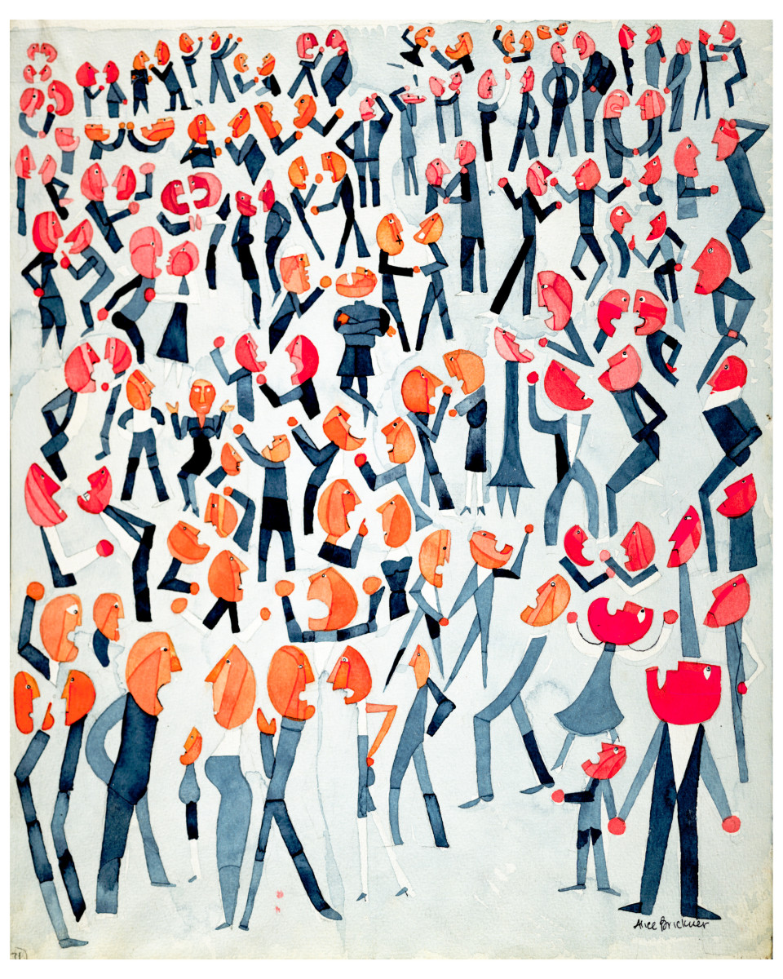
CONFLICT
Sensitive
Deeply personal
Potentially divisive
Affecting life choices

Slide 15

CONFLICT
Should the facilitator
of an LLF group
be neutral?

Slide 16
CONFLICT
Anticipate & welcome
Model curiosity
Inject hopefulness
Establish boundaries

Slide 17

Does someone have a different views?
Tell me more…
What led you to that conclusion?
CONFLICT
What new insights have we gained from this conversation?
We’ve talked about our disagreements. Where do we see common ground?
So this disagreement seems to be about…

Slide 18
1. Partnering
Facilitating
the
LLF Course
45 mins
2. Preparing
3. Performing
4. Pondering

Slide 19
1. Partnering
Facilitating
the
LLF Course
45 mins
2. Preparing
3. Performing
4. Pondering

Slide 20
1. Partnering
Facilitating
the
LLF Course
45 mins
2. Preparing
3. Performing
4. Pondering

Slide 21





Preparing . . .
The materials
The time
The participants
You

Slide 22
1. Partnering
Facilitating
the
LLF Course
45 mins
2. Preparing
3. Performing
4. Pondering

Slide 23

BRAVER AND SAFER
Intention
Personalising
Victimising
Impact
Imposing
Accusing
Ignorance

Slide 24
1. Partnering
Facilitating
the
LLF Course
45 mins
2. Preparing
3. Performing
4. Pondering

Slide 25
THANK YOU

